Slide 1

NFT IN HEALTHCARE
Devyani gautam
00619039523

Slide 2
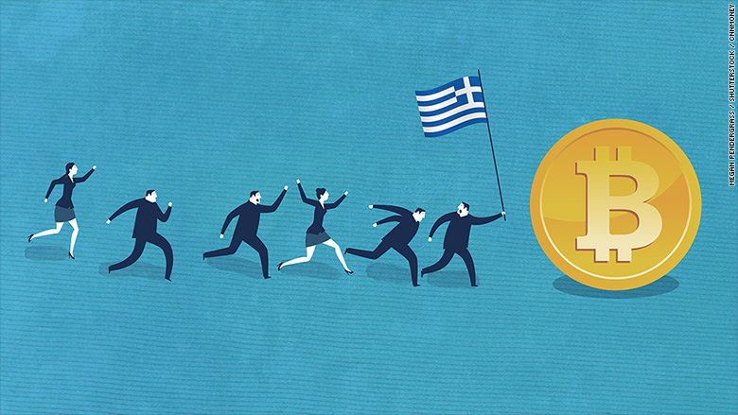
index
Introduction
Concepts
Project overview
Techniques used
Code demo with output
references

Slide 3
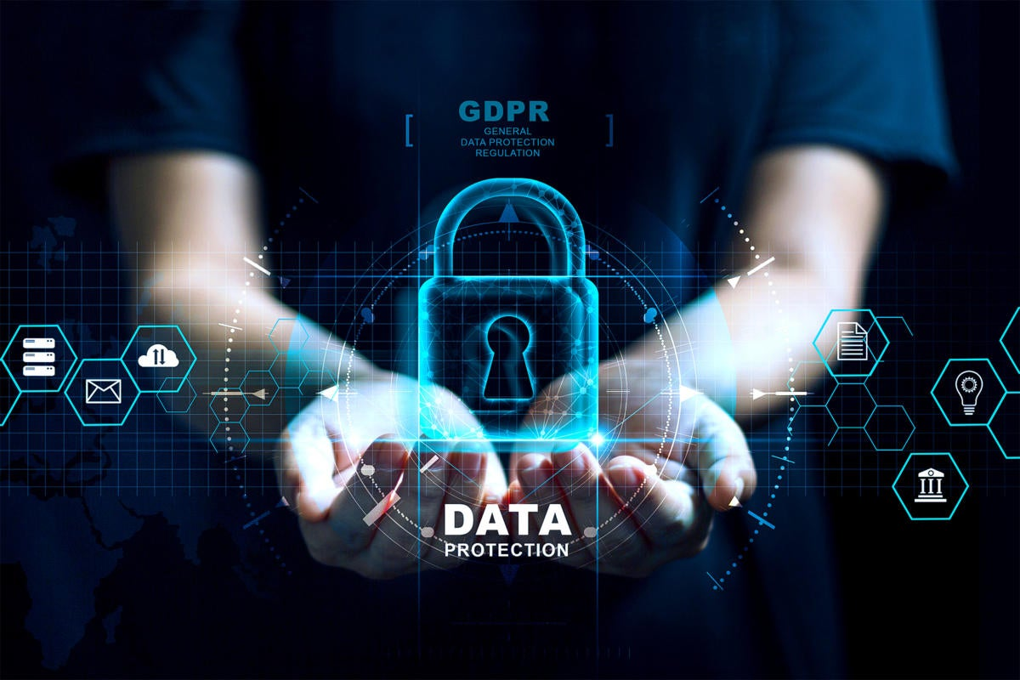
Introduction
Increasing volume of data from IoT devices and sensors
.
Urgent need to secure data exchange, particularly in healthcare
.
Blockchain serves as a solution for secure and transparent data exchange.
BLOCKCHAIN is a peer-to-peer, distributed ledger that is cryptographically secure, append-only, immutable, and updateable only via consensus or agreement among peers
This Photo by Unknown Author is licensed under CC BY

Slide 4
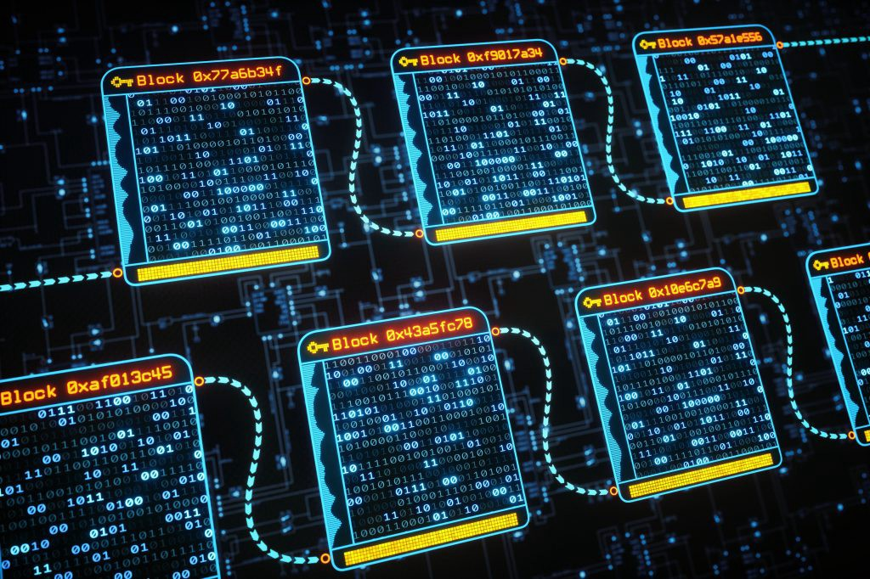
Example: A medical device company manufactures a pacemaker that needs to securely share censored data with a team of Doctors in JAPAN for remote monitoring and analysis.
this cross-border data sharing faces several challenges (especially in the field of healthcare) such as a lack of shared principles between Nations, advanced persistent threat (APT), etc...
Blockchain serves as the solution, derived from cryptographic principles and a decentralized architecture it serves as a significant enabling technology for trusted and secure data exchange.
NFT (non-fungible token ) one of the applications of blockchain can serve as the solution for secure data transfer

Slide 5
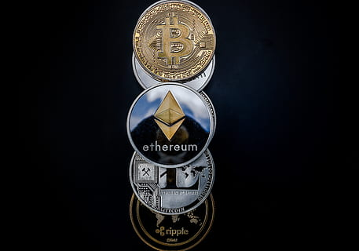
TOKENS
In economics, fungibility is the property of a good or a commodity whose individual units are essentially interchangeable i.e. indistinguishable.” When an item is fungible, it means it’s interchangeable with another of the same item. A classic example: a 1 dollar bill: you could swap dollars with someone and you’d both still have $1.
Tokens are fungible when we can substitute any single unit of the token for another without any difference in its value or function.
Non-fungible tokens are tokens that each represent a unique tangible or intangible item and therefore are not interchangeable. For example, a token that represents ownership of a specific Cultural painting is not equivalent to another token that represents Picasso, even though they might be part of the same “art ownership token” system

Slide 6

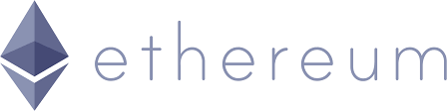
TYPES OF tokens
ERC-721
ERC-1155
The Ethereum Request for Comments 721 (ERC-721) is a proposal for a standard for non-fungible tokens, also known as DEEDS. The use of the word “deed” is intended to reflect the “ownership of property”.
Non-fungible tokens track ownership of a unique thing. The thing owned can be a digital item, such as an in-game item or digital collectible; or the thing can be a physical item whose ownership is tracked by a token, such as a house, a car, or an artwork. Deeds can also represent things with a negative value, such as loans (debt), liens, easements, etc.
Ethereum Request for Comments 1155,(ERC1155) is the latest standard for creating non-fungible tokens, offers certain advantages, including:
- More flexibility.
- Ability to create and use both fungible
and non-fungible tokens in the same
contract.
- Doing batch transfers.
- Better effectiveness in setting and
managing parameters.

Slide 7

PROJECT OVERVIEW
NFT-based solution uses blockchain smart contracts , tokenization protocols, and decentralized storage for an efficient medical device traceability and ownership management system. In this model, NFTs serve as digital twins, capturing essential attributes and metadata across the entire life cycle of the medical device, from production to current use.
1. We used NFTs as carriers for sensitive data in cross-border transfers, ensuring secure and authorized access. Harnessing the unique properties of NFTs, we employ the immutable NFT data as a tamperproof pointer, guaranteeing the authenticity and provenance of the sensitive information.
2. To address the public accessibility of NFT metadata, we propose leveraging the power of Steganography. This enables us to both conceal sensitive information and enhance its protection, offering an effective solution for privacy-conscious users.
3. To ensure secure and private user mobility across businesses, we propose an approach that prioritizes user data privacy and integrity during transitions. This objective is achieved through the application of a strong cryptographic technique, specifically OTP, which aligns with our model’s security requirements.

Slide 8
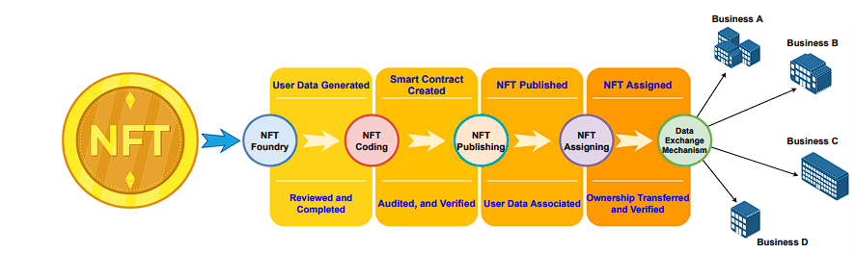
Techniques used -
Stages involved in transforming an NFT into a data exchange mechanism
figure outlines the four stages involved in transforming an NFT into a data exchange mechanism.
the foundry stage focuses on data generation and user verification.
the coding stage entails the development and verification of a smart contract.
3. the publishing stage, the NFT is published, and specific user data is linked to it.
4. the assignment stage grants the NFT to a user, enabling its function as a data exchange tool.

Slide 9
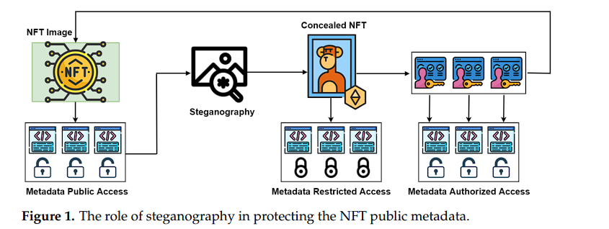
Steganography
Steganography is the art of covertly embedding private information within an ordinary and nonsensitive message, limiting awareness of the concealed content exclusively to the encoder and the intended decoder. Unlike encryption, which focuses on prohibiting data access, steganography is dedicated to masking the existence of the data itself.
The figure illustrates the public nature of NFT metadata. Using steganography on this data can restrict access, granting them only to authorized individuals identified by a specific business

Slide 10
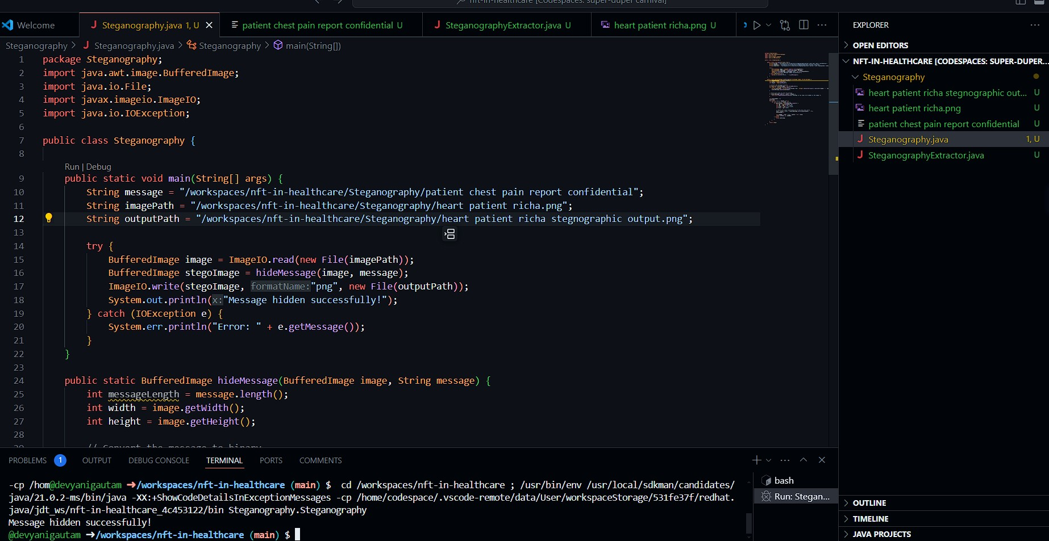
JAVA program for concealing Confidential information within the Image

Slide 11
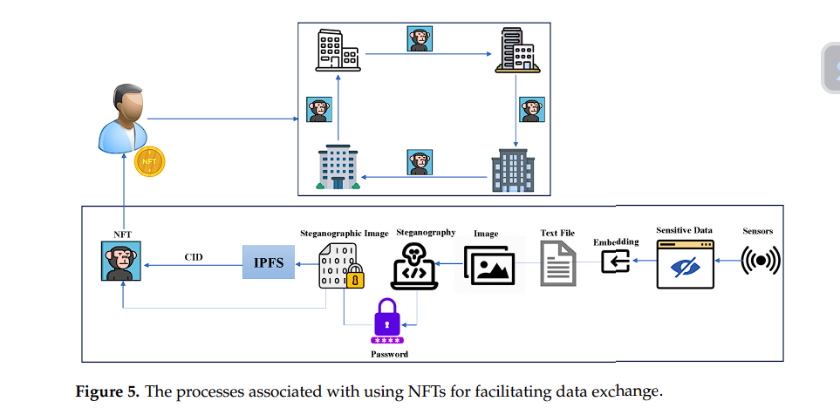
Sensitive user data samples, collected via sensors (e.g. sourced from the MHEALTH dataset), are stored in a human-readable format, typically a text file, and prepared for steganographic encoding alongside an image. Both the text file and the image undergo steganographic techniques to embed the data within the image, with added password security. The steganographic image is then uploaded to IPFS-(Inter Planetary File System - a decentralized storage system designed to create a peer-to-peer mechanism for storing and sharing data in a distributed manner, usually used because it is easy to access and cheaper to host data on it as compared to Ethereum ), its unique identifier(CID) is embedded within NFT metadata for reference, the unique identifier is used in the NFT smart contract to link an encrypted image with the metadata. This results in an NFT image containing sensor data, enabling secure data exchange among businesses through NFT ownership capabilities.

Slide 12
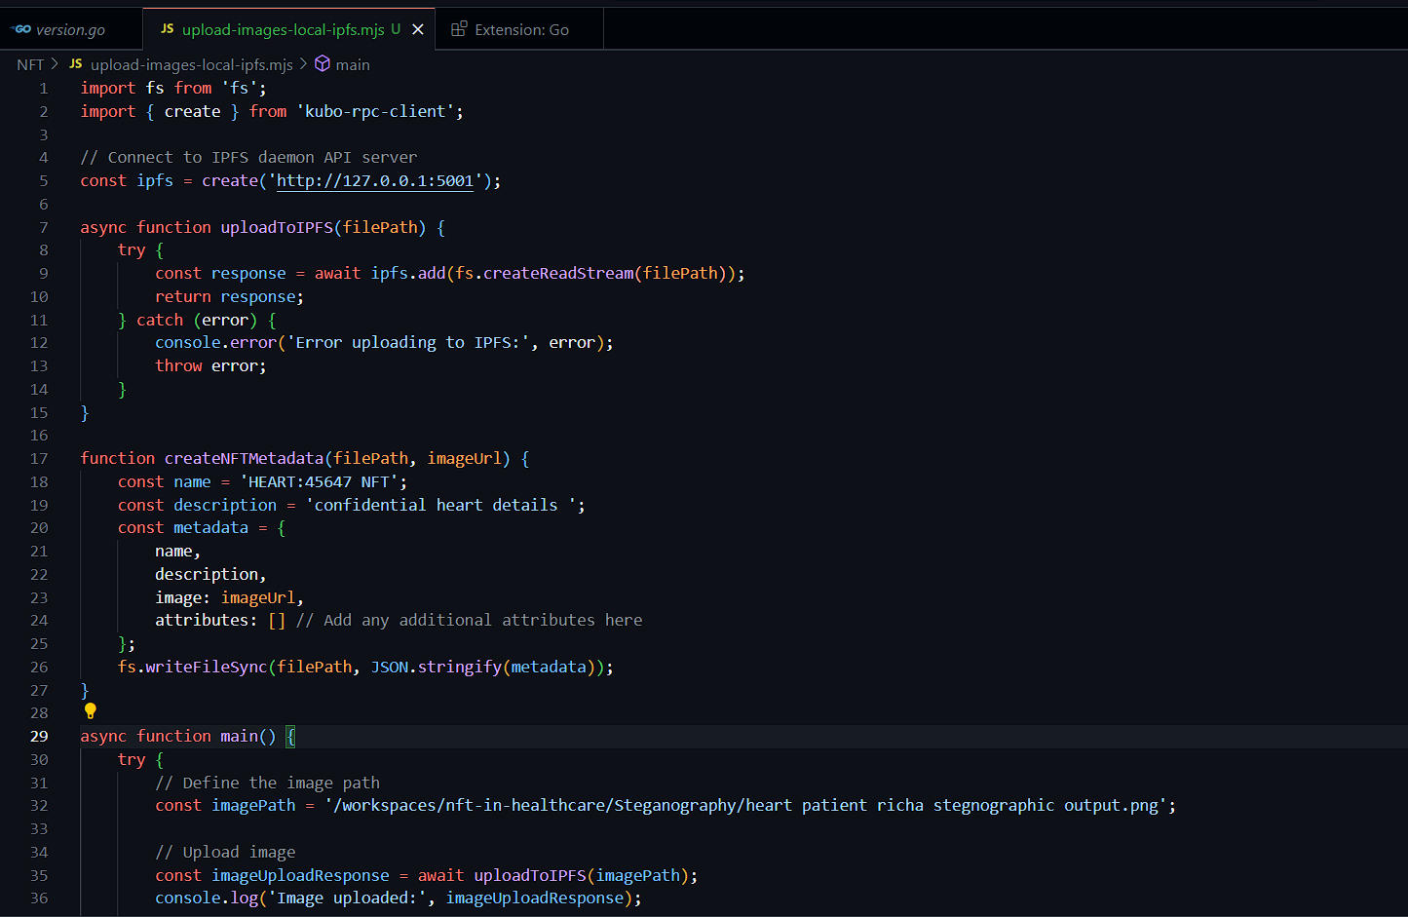
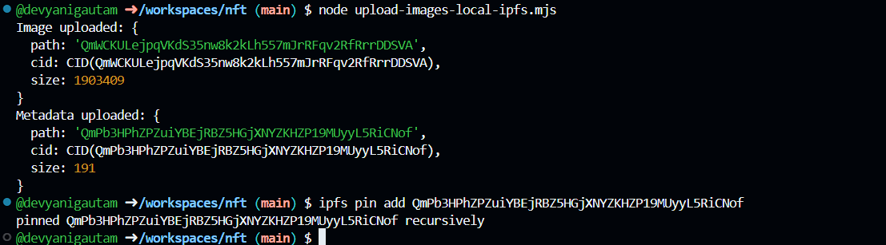
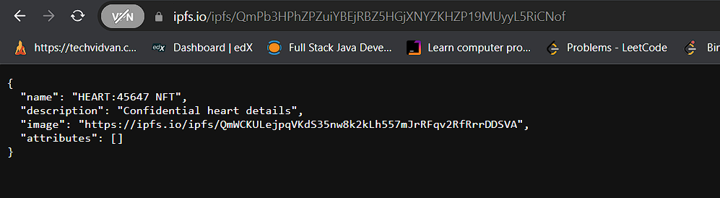
Sensitive user data samples, collected via sensors is being hidden inside the Image using JavaScript program and uploaded to the IPFS Network , results in giving CID number of uploaded image and metadata.

Slide 13
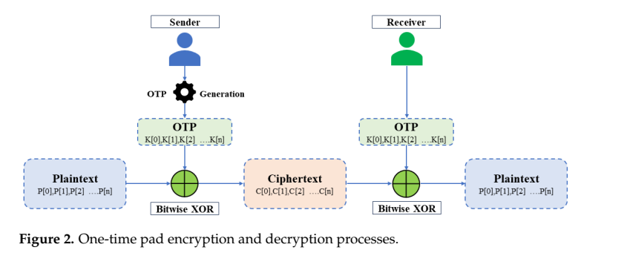
OTP
to ensure user data privacy and integrity during transitions , we use OTP(one time password)
accessing the data inside the NFT requires a password. Secure and unaltered transmission of this password is crucial.
The OTP, a one-and-done key, is never used twice, ensuring absolute secrecy. The user receives this key to unlock the steganography password in the receiving business or network when the need arises.

Slide 14
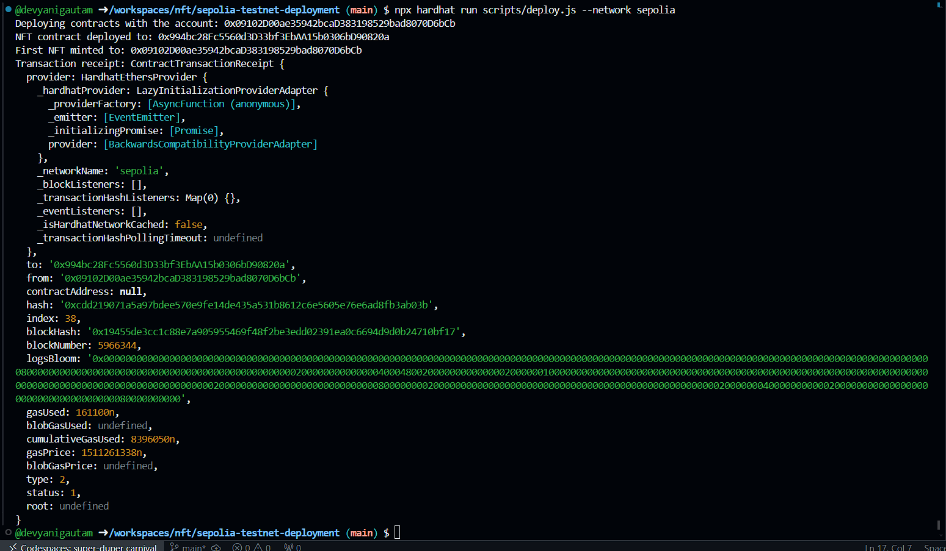
The NFT is successfully uploaded on sepolia network using hardhat development tool

Slide 15
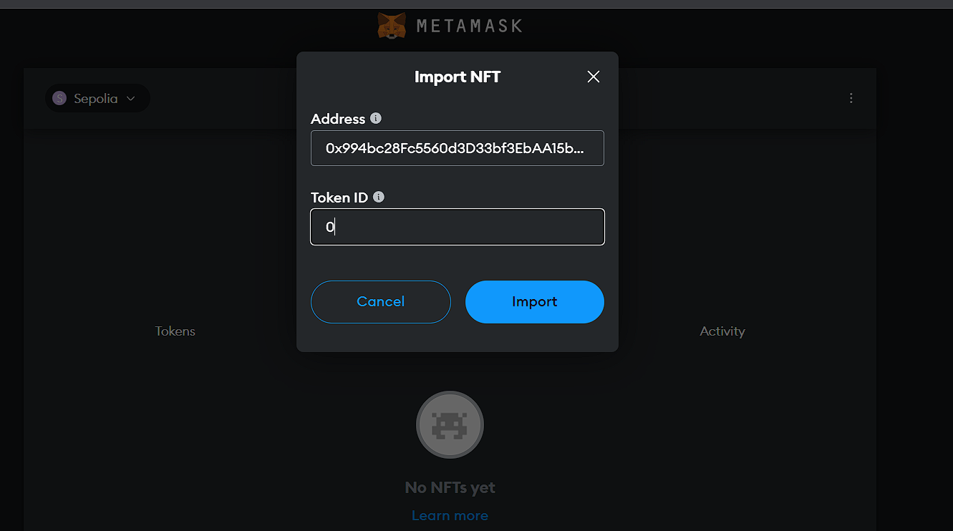
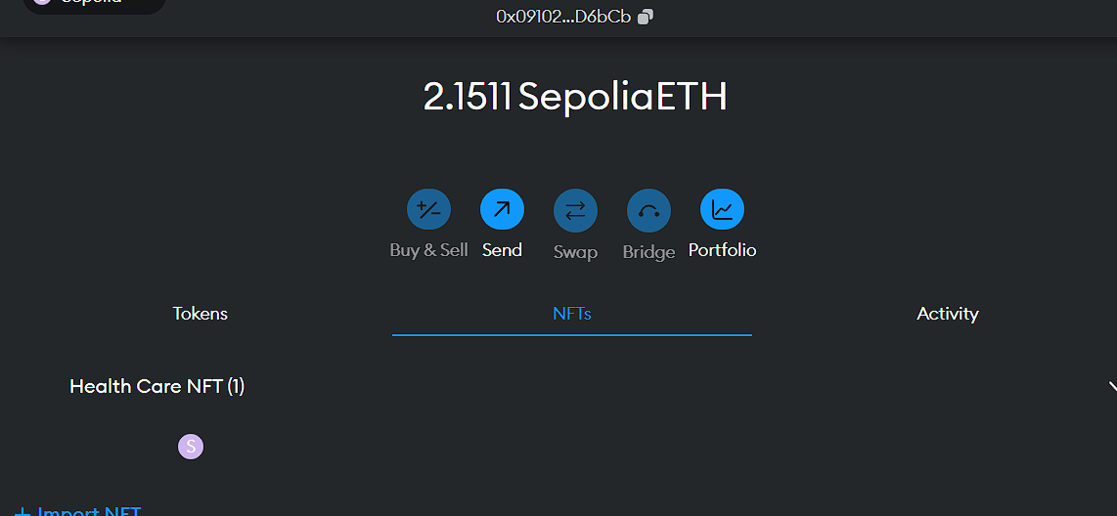
Healthcare NFT deployed on the sepolia network is visible on Metamask wallet

Slide 16
References -
Sensing Data Concealment in NFTs: A Steganographic Model for Confidential Cross-Border Information Exchange by Ghassan Al-Sumaidaee and Željko Žilić.
Mastering Ethereum Building Smart Contracts and DApps By Andreas M. Antonopoulos, Gavin Wood Ph.D. · 2018

Slide 17

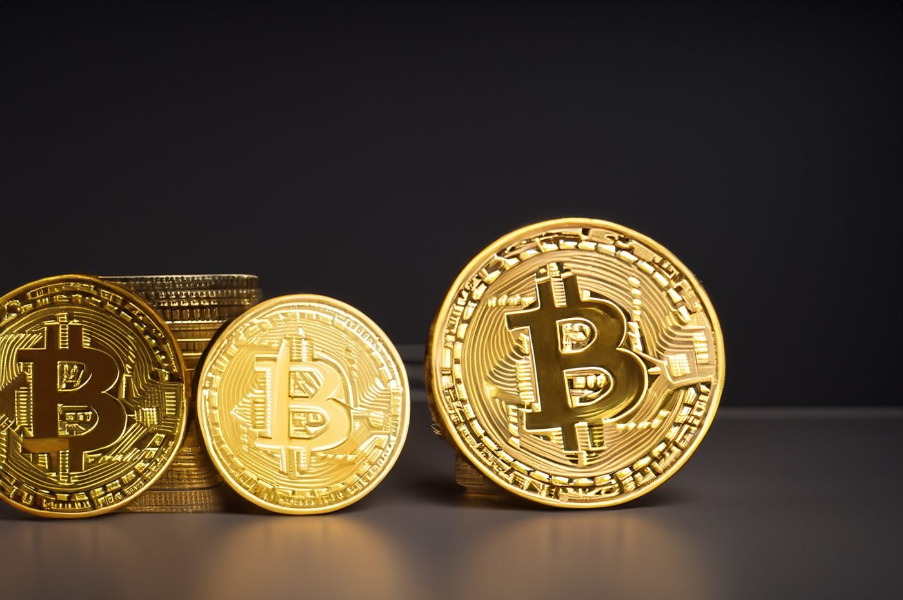

Thank you
This Photo by Unknown Author is licensed under CC BY-NC-ND

